Slide 1

SUBJECT : EMBEDDED SYSTEMS
UNIT – I
INTRODUCTION TO EMBEDDED SYSTEMS
KRISHNA PRASAD SATAMRAJU
ASSOCIATE PROFESSOR
DEPARTMENT OF ECE

Slide 2
EMBEDDED SYSTEMS
Embedded systems
An embedded system is an electronic/electro-mechanical system designed to perform a specific function .
It is a combination of specific-purpose hardware and software
This hardware comprises of
Analog electronic components
Analog Circuitry
Digital electronic components
Integrated Circuits (ICs)
PCBs (Printed Circuit Boards) provides a means to interconnect these components and make them function properly.
PCB act as a backbone in building embedded system.

Slide 3
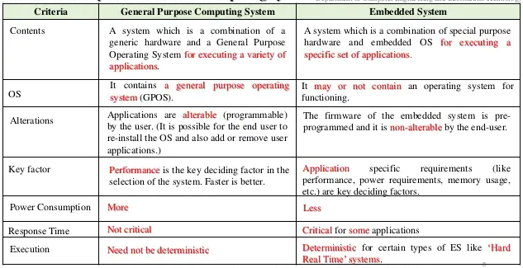
EMBEDDED SYSTEMS vs GENERAL PURPOSE COMPUTING SYSTEM

Slide 4
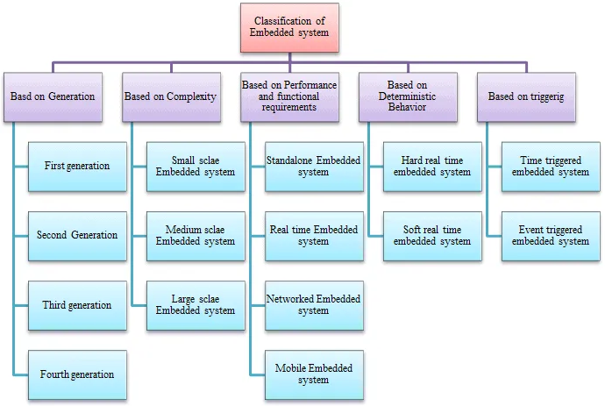
CLASSIFICATION OF EMBEDDED SYSTEMS

Slide 5
CLASSIFICATION OF EMBEDDED SYSTEMS Based on Generation
First Generation
Built around 8-bit microprocessor and 4-bit microcontroller.
Made up of simple hardware and firmware developed using assembly code.
Examples: Digital telephone keypads, Stepper motor control units.
Second Generation
Built around 16-bit microprocessor and 8-bit microcontroller.
Made up of complex hardware circuitry.
Examples: Data acquisition systems, SCADA systems.
Third Generation
Built around 32-bit microprocessor and 16-bit microcontroller.
Uses domain-specific processors/controllers like Digital Signal Processors (DSP), Application-Specific Integrated Circuits (ASICs) and the concept of instruction pipelining, embedded real-time operating system evolved into the embedded system industry.
Examples: Robotics, industrial process control, embedded networking.

Slide 6
CLASSIFICATION OF EMBEDDED SYSTEMS Based on Generation
Uses new concepts such as
System-on-Chip(SOC)
reconfigurable processors
multicore processors
Coprocessors
Provides more powerful performance in the embedded system.
These systems also make use of the high-performance real-time operating system for their operation.
Examples: Smart devices, digital cameras

Slide 7
CLASSIFICATION OF EMBEDDED SYSTEMS Based on Complexity and Performance Requirements
Small Scale Embedded Systems
Small Scale Embedded Systems are built with a single 8 or 16-bit microprocessor/controller.
The main programming tools used are an editor, assembler, cross assembler and integrated development environment (IDE).
It may or may not contain an operating system for its functioning.
An electronic toy is an example for a small-scale embedded system.
Medium Scale Embedded Systems
The Embedded system with medium performance 16-bit or 32-bit microprocessor/controller,
ASICs or DSPs fall under the medium scale embedded system.
They have both hardware and software complexities. The main programming tools used are C, C++, JAVA, Visual C++, RTOS, debugger, source code engineering tool, simulator and IDE.

Slide 8
CLASSIFICATION OF EMBEDDED SYSTEMS Based on Complexity and Performance Requirements
Large scale Embedded Systems
The embedded systems have highly complex hardware and software, built around 32-bit or 64-bit processors/controllers, RISC processors, SoC, scalable and configurable processors.
They are used for cutting-edge applications that need hardware and software Co-design, where components have to be assembled into the final system.
They also contain a high-performance real-time operating system for task scheduling, prioritization and management.

Slide 9
CLASSIFICATION OF EMBEDDED SYSTEMS Based on Functional Requirements
Standalone Embedded Systems
Standalone embedded systems are independent systems that do not depend on other systems. They work by themselves.
It takes the input either in analog or digital form, processes and produces the output. It may either control or drive the connected devices.
Examples: MP3 players, digital cameras, video game consoles, microwave ovens and temperature measurement systems.
Real Time Embedded Systems
A real-time embedded system is a system that gives a required output within a particular time.
These systems follow the time deadlines for the completion of a task. Real-time embedded systems are classified into two types such as soft and hard real-time systems.
Examples: Automotive airbag control system, flight control system.

Slide 10
CLASSIFICATION OF EMBEDDED SYSTEMS Based on Functional Requirements
Networked Embedded Systems
These embedded systems are related to a network to access the resources. The connected network can be LAN, WAN or the internet.
The connection can be wired or wireless. It is also the fastest growing area in embedded system applications.
Examples: Home security systems, ATM machines, card swipe machines are examples for the networked embedded system.
Mobile Embedded Systems
Mobile embedded systems are compact, easy to use and require fewer resources.
They are used in portable embedded devices like mobile phones, digital cameras, mp3 players and personal digital assistants, etc.

Slide 11
CLASSIFICATION OF EMBEDDED SYSTEMS Based on Deterministic Behavior
Hard Real time system
A hard real-time system must meet the timing deadlines without any delay. Missing the deadline would cause serious failure to the system or user.
Examples: The airbag control system and antilock braking system of vehicles.
Soft Real time system
Missing deadlines for tasks are acceptable for soft real-time systems, but the frequency of deadline missing should be within the compliance limit.
Example: ATM is a typical example of a soft real-time system.

Slide 12
CLASSIFICATION OF EMBEDDED SYSTEMS Based on Triggering
Time-triggered
If a system is activated or triggered based on the pre-defined task or preset time, then such system is said to be the time-triggered embedded system.
Event-triggered
On the other side, it the system is triggered based on some activity like change in temperature or change in pressure, such system is said to be an event triggered embedded system.

Slide 13
APPLICATION AREAS OF EMBEDDED SYSTEMS
Daily Life Electronic appliances( Lift, Microwave Oven, Refrigerator, Washing Machine)
HealthCare( X-ray, ECG, Cardiograph, diseases diagnosis devices etc)
Education (Laptop or desktop, projector, printer, calculator, lab equipments etc)
Communication( Mobile phone, satellite, Modem, Network Hub, Router, Telephone, Fax)
Security System( CC Camera, X ray Scanner, RFID System, Password protected door, Face detection)
Entertainment(Television etc)

Slide 14
APPLICATION AREAS OF EMBEDDED SYSTEMS
Banking System(ATM etc)
Automation
Navigation
Consumer Electronics: Camcorders, Cameras
Automotive industry: Anti-lock breaking system(ABS), engine control
Home automation & security systems: Air conditioners, sprinklers, fire alarms.
Telecom: Cellular phones, telephone switches.
Computer peripherals: Printers, scanners.
Computer networking systems: Network routers and switches.

Slide 15
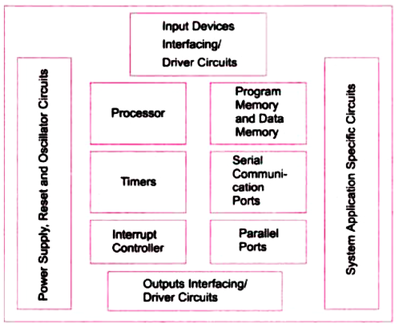
OVERVIEW OF AN EMBEDDED SYSTEMS

Slide 16
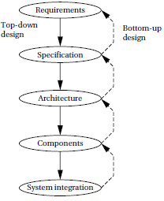
DESIGN OF AN EMBEDDED SYSTEMS

Slide 17
PURPOSE OF EMBEDDED SYSTEMS
Data Collection, Storage, Representation
Data Communication
Data Signal Processing
Monitoring
Control
Application Specific User Interface

Slide 18
PURPOSE OF EMBEDDED SYSTEMS Data Collection, Storage, Representation
Embedded system are designed for the purpose of data collection and performs acquisition of data from the external world. Data collection is usually done for storage, analysis, manipulation and transmission.
Data can be analog or digital. If the data is digital it can be directly captured by digital embedded system.
A digital camera is a typical example of an embedded System with data collection/storage/representation of data. Images are captured and the captured image may be stored within the memory of the camera. The captured image can also be presented to the user through a graphic LCD unit.

Slide 19
PURPOSE OF EMBEDDED SYSTEMS Data Communication
Embedded data communication systems are deployed in applications from complex satellite communication to simple home networking systems.
The transmission of data is achieved either by a wire-line medium or by a wire-less medium.
Data can either be transmitted by analog means or by digital means.
Wireless modules: Bluetooth, Wi-Fi.
Wire-line modules: USB, TCP/IP.
Network hubs, routers, switches are examples of dedicated data transmission embedded systems.

Slide 20
PURPOSE OF EMBEDDED SYSTEMS Data Signal Processing
Embedded systems with signal processing functionalities are employed in applications demanding signal processing like speech coding, audio video codec, transmission applications etc.
A digital hearing aid is a typical example of an embedded system employing data processing.
Digital hearing aid improves the hearing capacity of hearing impaired person

Slide 21
PURPOSE OF EMBEDDED SYSTEMS Monitoring
All embedded products coming under the medical domain are with monitoring functions.
Electro cardiogram machine is intended to do the monitoring of the heartbeat of a patient but it cannot impose control over the heartbeat.
Other examples with monitoring function are digital CRO, digital multi-meters, and logic analyzers.

Slide 22
PURPOSE OF EMBEDDED SYSTEMS Control
A system with control functionality contains both sensors and actuators.
Sensors are connected to the input port for capturing the changes in environmental variable.
The actuators connected to the output port are controlled according to the changes in the input variable.
Air conditioner system used to control the room temperature to a specified limit is a typical example for CONTROL purpose.

Slide 23
PURPOSE OF EMBEDDED SYSTEMS Application Specific User Interface
Buttons, switches, keypad, lights, bells, display units etc. are application specific user interfaces.
Mobile phone is an example of application specific user interface.
In mobile phone the user interface is provided through the keypad, system speaker, vibration alert etc.

Slide 24
TYPICAL EMBEDDED SYSTEMS
Core of the Embedded System
Memory
Sensors and Actuators
Communication Interface
Embedded Firmware
Other System Components

Slide 25
TYPICAL EMBEDDED SYSTEMS Core of the Embedded System
General Purpose and domain Specific Processors
Application Specific ICs
Programmable Logic Devices
Commercial Off the Shelf Components (COTS)

Slide 26
TYPICAL EMBEDDED SYSTEMS Core of the Embedded System
General Purpose and domain Specific Processors
Microprocessors
Microcontrollers
Digital Signal Processors

Slide 27
TYPICAL EMBEDDED SYSTEMS Core of the Embedded System
Application Specific Integrated Circuits
ASICs is a microchip design to perform a specific and unique applications.
Most of the ASICs are proprietary (which having some trade name) products, it is referred as Application Specific Standard Products(ASSP).
As a single chip ASIC consumes a very small area in the total system and helps in the design of smaller system with high capabilities or functionalities.
The developers of such chips may not be interested in revealing the internal detail of it .

Slide 28
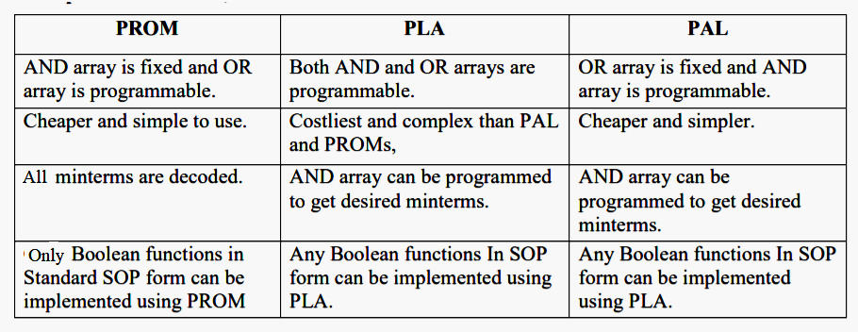
TYPICAL EMBEDDED SYSTEMS Core of the Embedded System
Programmable Logic Devices
They contain an array of AND gates & another array of OR gates. There are three kinds of PLDs based on the type of arrays, which has programmable feature.
Programmable Logic Array (PLA)
Programmable Read Only Memory (PROM)
Programmable Array Logic (PAL)
The process of entering the information into these devices is known as programming.

Slide 29
TYPICAL EMBEDDED SYSTEMS Core of the Embedded System
Commercial Off-The-Shelf (COTS) components
ASICs is a microchip design to perform a specific and unique applications.
Most of the ASICs are proprietary (which having some trade name) products, it is referred as Application Specific Standard Products(ASSP).
As a single chip ASIC consumes a very small area in the total system and helps in the design of smaller system with high capabilities or functionalities.
The developers of such chips may not be interested in revealing the internal detail of it .
Advantages of COTS:
Ready to use
Easy to integrate
Reduces development time
Disadvantages of COTS:
No operational or manufacturing .standard (all proprietary)
Vendor or manufacturer may discontinue production of a particular COTS product

Slide 30
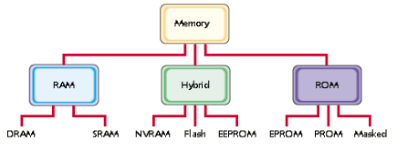
TYPICAL EMBEDDED SYSTEMS Memory

Slide 31
TYPICAL EMBEDDED SYSTEMS Memory
Three Main Types
RAM (Random Access Memory) It is read write memory.
Data at any memory location can be read or written.
It is volatile memory, i.e. retains the contents as long as electricity is supplied.
ROM (Read Only Memory) It is read only memory.
Data at any memory location can be only read.
It is non-volatile memory, i.e. the contents are retained even after electricity is switched off and available after it is switched on. Data access to ROM is slow compared to RAM.
HYBRID It is combination of RAM as well as ROM
It has certain features of RAM and some of ROM
Like RAM the contents to hybrid memory can be read and written Like ROM the contents of hybrid memory are non volatile.

Slide 32
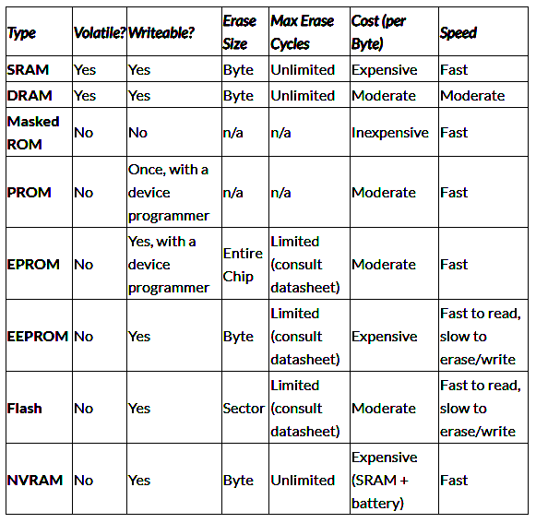
TYPICAL EMBEDDED SYSTEMS Memory

Slide 33
TYPICAL EMBEDDED SYSTEMS Memory – Memory Shadowing
Typically the ROM contains the start up code as well as the system software. When the CPU is reset it will start executing this start-up code. As part of the initialization, the contents of the ROM is copied into the RAM area where it can be execute
This is a technique that is probably best known from its implementation with the BIOS ROMs used in a PC.
The idea behind shadowing is to copy the contents of the slow ROM into faster RAM and execute the code from the RAM. As a result the time taken to execute the code is greatly reduced.
The shadowing refers to the fact that the RAM contains a copy of the original ROM contents.
This mechanism can be implemented with
Hardware Assisted
Pure Software based

Slide 34
TYPICAL EMBEDDED SYSTEMS Memory – Memory Shadowing
Hardware Assisted
With a hardware assisted implementation, the address decode logic is used to switch the address decode to select the RAM instead of the ROM. As a result, any access to the ROM will be automatically switched to the RAM and will execute faster and without any change in the software as the addressing has not changed.
Virtually all IBM PCs implement their shadowing for the BIOS ROMs using this technique. It is also possible to use a MMU to perform the address translation if needed.
Pure Software based
In the pure software-based system, the software that is copied is now in a different memory location and providing the software was compiled and linked to execute in this location, there is no need to use any memory address translation.

Slide 35
TYPICAL EMBEDDED SYSTEMS Memory – Memory Selection for Embedded Systems
Selection of suitable memory is very much essential step in high performance applications, because the challenges and limitations of the system performance are often decided upon the type of memory architecture.
Systems memory requirement depend primarily on the nature of the application that is planned to run on the system.
The factors that are to be considered while selecting the memory devices are
Speed
Data storage size and capacity
Bus width
Latency
Power consumption
Cost

Slide 36
TYPICAL EMBEDDED SYSTEMS Sensors and Actuators
A sensor is a transducer device that converts energy from one form to another for any measurement or control purpose.
The changes in system environment or variables are detected by the sensors connected to the input port of the embedded system.
Actuator is a form of transducer device (mechanical or electrical) which converts signals to corresponding physical action (motion).
Actuator acts as an output device.
The I/O subsystem of the embedded system facilitates the interaction of the embedded system with the external world.
The interaction happens through the sensors and actuators connected to the input and output ports respectively of the embedded system.
The sensors may not be directly interfaced to the input ports, instead they may be interfaced through signal conditioning and translating systems like ADC, optocouplers, etc.

Slide 37
TYPICAL EMBEDDED SYSTEMS Sensors and Actuators
Light Emitting Diode (LED)
7-Segment LED Display
Optocoupler
Stepper Motor
Relay
Piezo Buzzer
Push Button Switch
Keyboard
Programmable Peripheral Interface (PPI)

Slide 38
TYPICAL EMBEDDED SYSTEMS Communication Interface
Communication interface is essential for data transfer between various modules connected to the embedded system. It acts as an external interface between embedded world and real-world.
Different communication interfaces available in embedded world are
On-board Communication Interfaces
Inter Integrated Circuit (IIC/I2C/I²C) Bus
Serial Peripheral Interface (SPI) Bus
Universal Asynchronous Receive Transmit (UART) Bus
1-Wire Bus
Parallel Interface
External Communication Interface
RS-232 and RS-485
USB
IEEE 1394 (Firewire)
Infrared (IRrDA)
Bluetooth
Wi-Fi
Zigbee

Slide 39
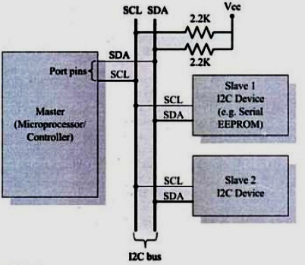
TYPICAL EMBEDDED SYSTEMS On-board Communication Interface – Inter Integrated Circuit (I2C) Bus

Slide 40
TYPICAL EMBEDDED SYSTEMS On-board Communication Interface – Inter Integrated Circuit (I2C) Bus
It is a serial communications protocol that uses a simple, bidirectional two-wire synchronous serial bus and requires only two wires to transmit information between devices connected to the bus.
They are useful for projects that require many different parts working together as they can connect up to 128 devices to the mainboard while maintaining a clear communication pathway.
This is because I2C uses an address (8-bit) system and a shared bus = many different devices can be connected using the same wires and all data are transmitted on a single wire and have a low pin count. Speed of I2C is also dependent by data speed, wire quality and external noise
The I2C protocol is also used as a two-wire interface to connect low-speed devices like microcontrollers, EEPROMs, A/D and D/A converters, I/O interfaces and other similar peripherals in embedded systems.

Slide 41
TYPICAL EMBEDDED SYSTEMS On-board Communication Interface – Inter Integrated Circuit (I2C) Bus
The master sends the transmitting signal to every connected slave by switching the SDA line from a high voltage level to a low voltage level and SCL line from high to low after switching the SDA line.
The master sends each slave the 7 or 10-bit address of the slave and a read/write bit to the slave it wants to communicate with.
The slave will then compare the address with its own. If the address matches, the slave returns an ACK bit which switches the SDA line low for one bit. If the address does not match its address, the slave leaves the SDA line high
The master will then send or receive the data frame. After each data frame has been transferred, the receiving device returns another ACK bit to the sender to acknowledge successful transmission.
To stop the data transmission, the master sends a stop signal to the slave by switching SCL high before switching SDA high

Slide 42
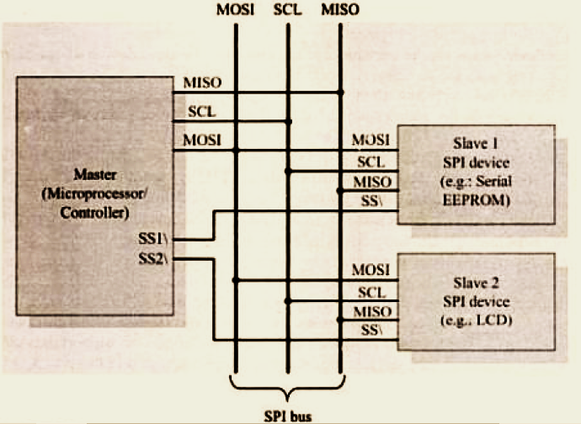
TYPICAL EMBEDDED SYSTEMS On-board Communication Interface – Serial Peripheral Interface

Slide 43
TYPICAL EMBEDDED SYSTEMS On-board Communication Interface – Serial Peripheral Interface
Operates at full-duplex where data can be sent and received simultaneously.
Operate at faster data transmission rates = 8Mbps or more
The SPI communicates via 4 ports which are:
MOSI – Master Data Output, Slave Data Input
MISO – master data input, slave data output
SCLK – clock signal, generated by the master device, up to fPCLK/2, slave mode frequency up to fCPU/2
SS – Slave enabled signal, controlled by the master device, some ICs will be labelled as CS (Chip select)

Slide 44
TYPICAL EMBEDDED SYSTEMS On-board Communication Interface – Serial Peripheral Interface
Communicate with 2 ways:
Selecting each device with a Chip Select line. A separate Chip Select line is required for each device. This is the most common way Raspberry Pi currently use SPI.
Daisy chaining where each device is connected to the other through its data out to the data in line of the next.
There is no limit to the number of SPI device that can be connected.
However, there are practical limits due to the number of hardware select lines available on the main device with the chip select method or the complexity of passing data through devices in the daisy-chaining method.
In point-to-point communication, the SPI interface does not require addressing operations and is full-duplex communication, which is simple and efficient.

Slide 45
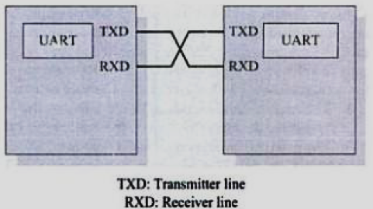
TYPICAL EMBEDDED SYSTEMS On-board Communication Interface – UART
A UART that is transmitting data will first receive data from a data bus that is sent by another component (eg. CPU).
After getting the data from the data bus, it will add a start bit, a parity bit, and a stop bit to create the data packet.
The data packet is then transmitted at the TX pin where the receiving UART will read the data packet at its RX pin. Data is sent until there is no data left in the transmitting UART.

Slide 46
TYPICAL EMBEDDED SYSTEMS On-board Communication Interface – UART
Once data is being transmitted by the transmit FIFO, the FIFO ‘BUSY’ flag will be asserted and active during the process.
FIFO = First in, First out.
It’s a UART buffer that that forces each byte to be passed in sequence to the receiving UART.
The ‘BUSY’ bit will only be inactive after data is finished transmitting, the FIFO is emptied and every bit has been transmitted including the stop bit.

Slide 47
TYPICAL EMBEDDED SYSTEMS External Communication Interface – USB
The Universal Serial Bus (USB) is the most widely used interconnection standard.
A large variety of devices are available with a USB connector, including mice, memory keys, disk drives, printers, cameras, and many more.
The commercial success of the USB is due to its simplicity and low cost.
The original USB specification supports two speeds of operation, called low-speed (1.5 Megabits/s) and full-speed (12 Megabits/s). Later, USB 2, called High-Speed USB, was introduced. It enables data transfers at speeds up to 480 Megabits/s.
As I/O devices continued to evolve with even higher speed requirements, USB 3 (called Superspeed) was developed. It supports data transfer rates up to 5 Gigabits/s.
Objectives
Provide a simple, low-cost, and easy to use interconnection system
Accommodate a wide range of I/O devices and bit rates, including Internet connections, and audio and video applications
Enhance user convenience through a “plug-and-play” mode of operation

Slide 48
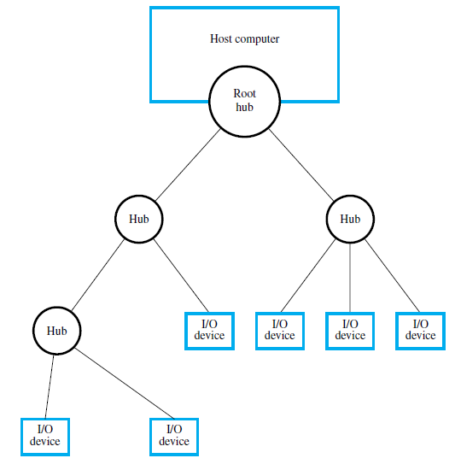
TYPICAL EMBEDDED SYSTEMS External Communication Interface – USB Architecture

Slide 49
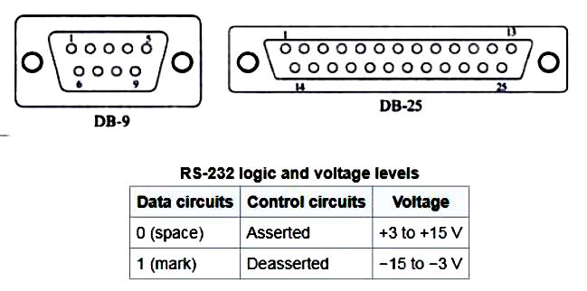
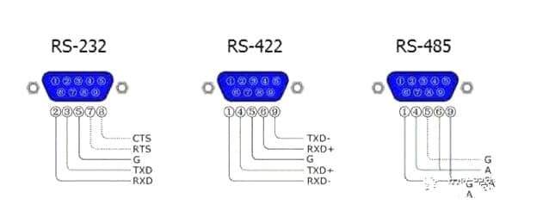
TYPICAL EMBEDDED SYSTEMS External Communication Interface – RS-232
RS-232, Recommended Standard 232 formally defines the signals connecting between a DTE (data terminal equipment) such as a computer terminal, and a DCE (data circuit terminating equipment or data communication equipment), such as a modem. The RS-232 standard had been commonly used in computer serial ports.

Slide 50
TYPICAL EMBEDDED SYSTEMS External Communication Interface – Wireless
IrDA (Infrared Data Association)
Communicates over a line of sight Phototransistor receiver for infrared rays
Bluetooth 2.4 GHz
Bluetooth is a wireless technology standard for exchanging data over short distances (using short wavelength UHF radio waves in the ISM band from 2.4 to 2.485 GHz) from fixed and mobile devices, and building personal area networks(PANs).
802.11 WLAN and 802.11b Wi-Fi
Technology for wireless local area networking with devices based on the IEEE 802.11standards. Wi-Fi is a trademark of the Wi-Fi Alliance, which restricts the use of the term Wi-Fi Certified to products that successfully complete interoperability certification testing.
Devices that can use Wi-Fi technology include personal computers, video-game consoles, phones and tablets, digital cameras, smart TVs, digital audio players and modern printers. Wi-Fi compatible devices can connect to the Internet via a WLAN and a wireless access point. Such an access point (or hotspot) has a range of about 20 meters
ZigBee 900 MHz

Slide 51
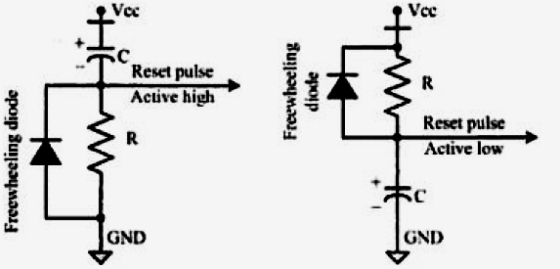
OTHER SYSTEM COMPONENTS Reset Circuit

Slide 52
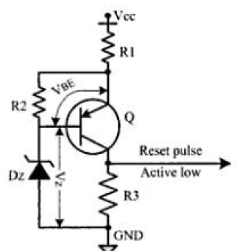
OTHER SYSTEM COMPONENTS Brown-Out Protection Circuit
Three major factors that can damage the connected embedded system are:
An unregulated direct current supply will produce a lower output voltage for electronic circuits. The output ripple voltage will decrease in line with the usually reduced load current.
A linear direct current regulated supply will maintain the output voltage unless the brownout is severe and the input voltage drops below the drop out voltage for the regulator, at which point the output voltage will fall and high levels of ripple from the rectifier/reservoir capacitor will appear on the output.
A switched-mode power supply which has a regulated output will be affected. As the input voltage falls, the current draw will increase to maintain the same output voltage and current, until such a point that the power supply malfunctions.

Slide 53
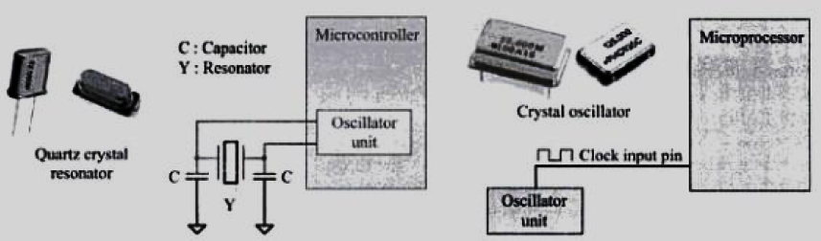
OTHER SYSTEM COMPONENTS Oscillator Circuit

Slide 54
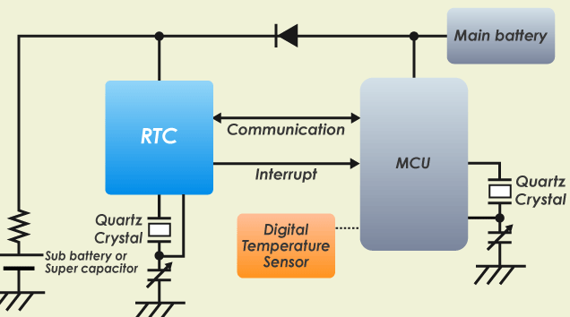
OTHER SYSTEM COMPONENTS Real-Time Clock (RTC)
Real-time clock is a clock function used by systems that measure time even when the main device (such as MCU) is powered off. For example, even when the main battery or power supply is removed from a camera or gaming device, system can measure time by powering the real-time clock from a sub-battery or super capacitor built into that system.

Slide 55
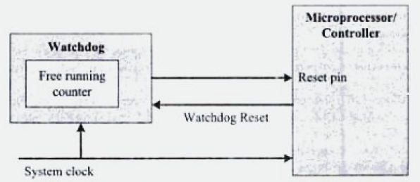
OTHER SYSTEM COMPONENTS Watchdog Timer
Watchdog timer (sometimes called a computer operating properly or COP timer, or simply a watchdog) is an electronic or software timer that is used to detect and recover from computer malfunctions.
During normal operation, the computer regularly restarts the watchdog timer to prevent it from elapsing, or "timing out".

Slide 56
CHARACTERISTICS OF EMBEDDED SYSTEMS
Application and Domain specific
An embedded system is designed for a specific purpose only. It will not do any other task.
A washing machine can only wash, it cannot cook.
Reactive and Real time
Certain Embedded systems are designed to react to the events that occur in the nearby environment. These events also occur real-time.
An air conditioner adjusts its mechanical parts as soon as it gets a signal from its sensors to increase or decrease the temperature when the user operates it using a remote control.
Operation in harsh environment
Certain embedded systems are designed to operate in harsh environments like very high temperature of the deserts or very low temperature of the mountains or extreme rains.
These embedded systems have to be capable of sustaining the environmental conditions it is designed to operate in.

Slide 57
CHARACTERISTICS OF EMBEDDED SYSTEMS
Distributed
Certain embedded systems are part of a larger system and thus form components of a distributed system.
These components are independent of each other but have to work together for the larger system to function properly.
A car has many embedded systems controlled to its dash board. Each one is an independent embedded system yet the entire car can be said to function properly only if all the systems work together.
Small size and weight
An embedded system that is compact in size and has light weight will be desirable or more popular than one that is bulky and heavy.
Currently available cell phones.
Power concerns
It is desirable that the power utilization and heat dissipation of any embedded system be low. If more heat is dissipated then additional units like heat sinks or cooling fans need to be added to the circuit.

Slide 58
QUALITY ATTRIBUTES OF EMBEDDED SYSTEMS
There are two types of quality attributes.
Operational Quality Attributes.
These are attributes related to operation or functioning of an embedded system. The way an embedded system operates affects its overall quality.
Non-Operational Quality Attributes.
These attributes are not related to operation or functioning of an embedded system. The way an embedded system operates affects its overall quality.
These are the attributes that are associated with the embedded system before it can be put in operation.

Slide 59
QUALITY ATTRIBUTES OF EMBEDDED SYSTEMS Operational
Response
Response is a measure of quickness of the system. It gives you an idea about how fast your system is tracking the input variables.
Most of the embedded system demand fast response which should be real-time.
Throughput
Throughput deals with the efficiency of system. It can be defined as rate of production or process of a defined process over a stated period of time.
In case of card reader like the ones used in buses, throughput means how much transaction the reader can perform in a minute or hour or day.

Slide 60
QUALITY ATTRIBUTES OF EMBEDDED SYSTEMS Operational
Reliability
Reliability is a measure of how much percentage you rely upon the proper functioning of the system. Mean Time between failures and Mean Time To Repair are terms used in defining system reliability.
Mean Time Between Failures (MTBF)
Mean Time between failures can be defined as the average time the system is functioning before a failure occurs.
Mean time to repair can be defined as the average time the system has spent in repairs.
Security
Confidentiality, Integrity and Availability are three corner stones of information security.
Confidentiality deals with protection data from unauthorized disclosure.
Integrity gives protection from unauthorized modification.
Availability gives protection from unauthorized user

Slide 61
QUALITY ATTRIBUTES OF EMBEDDED SYSTEMS Operational
Maintainability
Maintainability deals with support and maintenance to the end user or a client in case of technical issues and product failures or on the basis of a routine system checkup
It can be classified into two types :-
Scheduled or Periodic Maintenance : This is the maintenance that is required regularly after a periodic time interval.
Example : Periodic Cleaning of Air Conditioners, Refilling of printer cartridges.
Maintenance to unexpected failure: This involves the maintenance due to a sudden breakdown in the functioning of the system.
Example: Air conditioner not powering on, Printer not taking paper in spite of a full paper stack
Safety
Safety deals with the possible damage that can happen to the operating person and environment due to the breakdown of an embedded system or due to the emission of hazardous materials from the embedded products.
A safety analysis is a must in product engineering to evaluate the anticipated damage and determine the best course of action to bring down the consequence of damages to an acceptable level.

Slide 62
QUALITY ATTRIBUTES OF EMBEDDED SYSTEMS Non-Operational
Testability and Debug-ability
It deals with how easily one can test his/her design, application and by which mean he/she can test it.
In hardware testing the peripherals and total hardware function in designed manner
Firmware testing is functioning in expected way
Debug-ability is means of debugging the product as such for figuring out the probable sources that create unexpected behavior in the total system
Evolvability
“Evolvability” refer to ease with which the embedded product can be modified to take advantage of new firmware or hardware technology.
Portability
Portability is measured of “system Independence”. An embedded product can be called portable if it is capable of performing its operation as it is intended to do in various environments irrespective of different processor and or controller and embedded operating systems.

Slide 63
QUALITY ATTRIBUTES OF EMBEDDED SYSTEMS Non-Operational
Time to prototype and market
Time to Market is the time elapsed between the conceptualization of a product and time at which the product is ready for selling or use
Product prototyping help in reducing time to market.
Prototyping is an informal kind of rapid product development in which important feature of the under consider are develop.
In order to shorten the time to prototype, make use of all possible option like use of reuse, off the self component etc.
Per unit and total cost
Cost is an important factor which needs to be carefully monitored. Proper market study and cost benefit analysis should be carried out before taking decision on the per unit cost of the embedded product.
When the product is introduced in the market, for the initial period the sales and revenue will be low
During the maturing phase, the growth will be steady and revenue reaches highest point and at retirement time there will be a drop in sales volume.

Slide 64
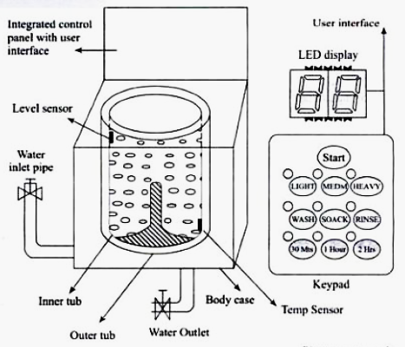
APPLICATION-SPECIFIC EMBEDDED SYSTEM Washing Machine

Slide 65
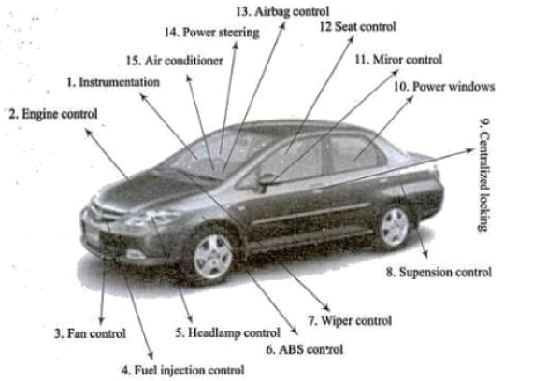
DOMAIN-SPECIFIC EMBEDDED SYSTEM Automotive

Slide 66
Assignment Questions
Differences between
Microprocessor and Microcontroller
Von-Nuemann and Harvard Architectures
RISC vs. CISC
Little-Endian vs. Big-Endian
Firmware vs Software.
Few points related to Sensors and Actuators listed in the classroom.

Slide 67
END OF UNIT - I

